Slide 1

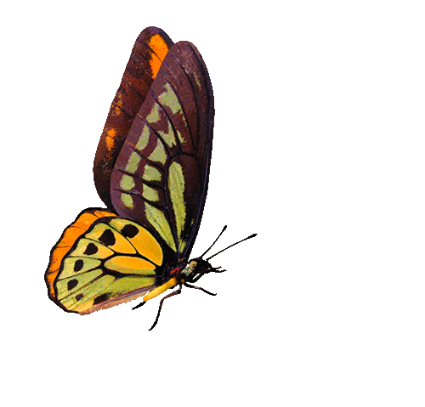
Butterfly Mating Optimization
Chakravarthy Sir, Vinod Babu Sir
N151280 - A.Ravi Teja
N150712 - A. Bhuvana Priya
N150902 - G.Divya
N150574 - P.Aswini

Slide 2

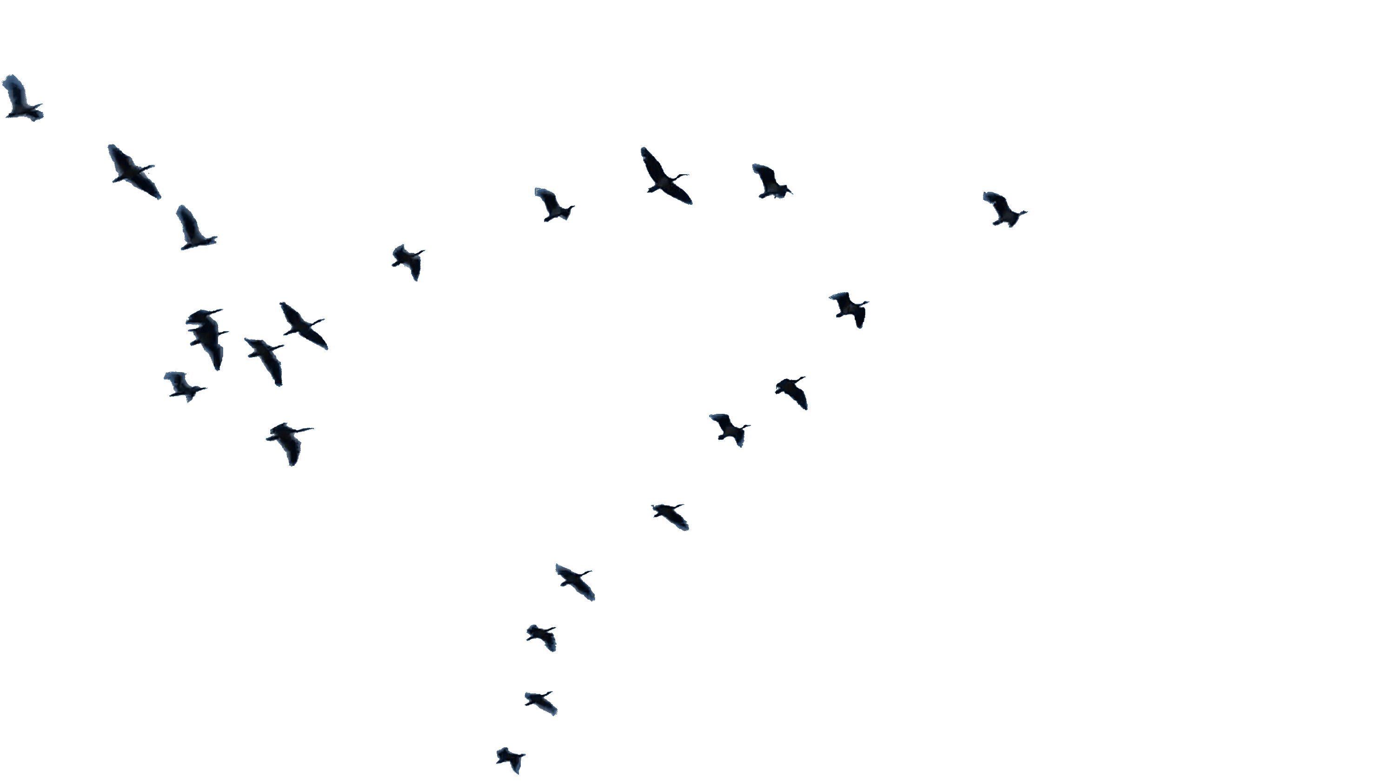
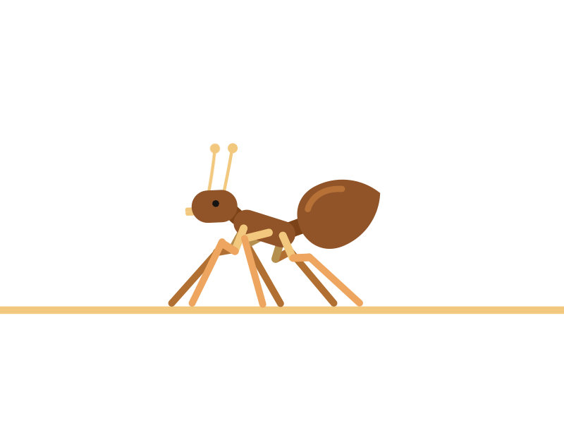
Swarm intelligence based algorithms :
Glow Worm Swarm Optimization
Particle Swarm Optimization
Ant Colony Optimization

Slide 3

Patrolling Mating Mechanism :
Male

Slide 4
BMO ALGORITHM :
1 . UV Updation Phase
UV i (t) = max{0,b 1 ∗UV i (t − 1) + b 2 ∗ f (t)} 0 ≤ b 1 ≤ 1, b 2 > 1
2 . UV Distribution Phase

Slide 5
BMO ALGORITHM :
3 . L-mate Selection Phase
UV(i th Bfly) < UV(j th Bfly)
4. Movement Phase

Slide 6
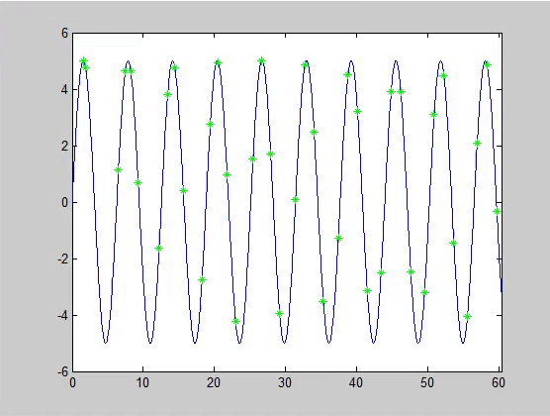
2D Matlab Simmulations :

Slide 7
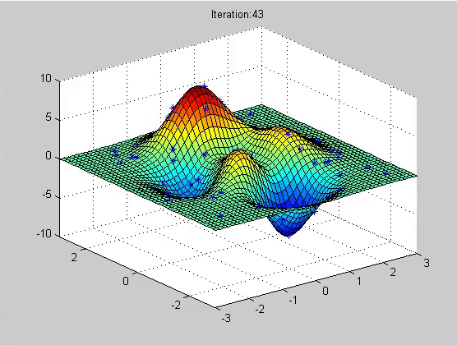
3D Matlab Simmulations :

Slide 8

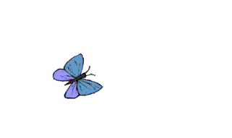
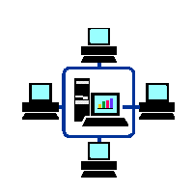

Hardware Implimentation:
PHASE II
Communicate with
the other Bflybots
PHASE I
Finding the signal source
strength
Bfly Bot
PHASE IV
Movement towards its L-mate
PHASE III
Selecting L-mate

Slide 9
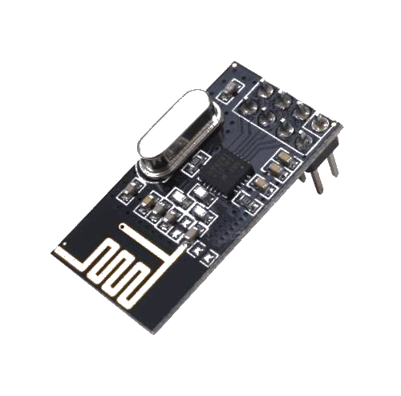
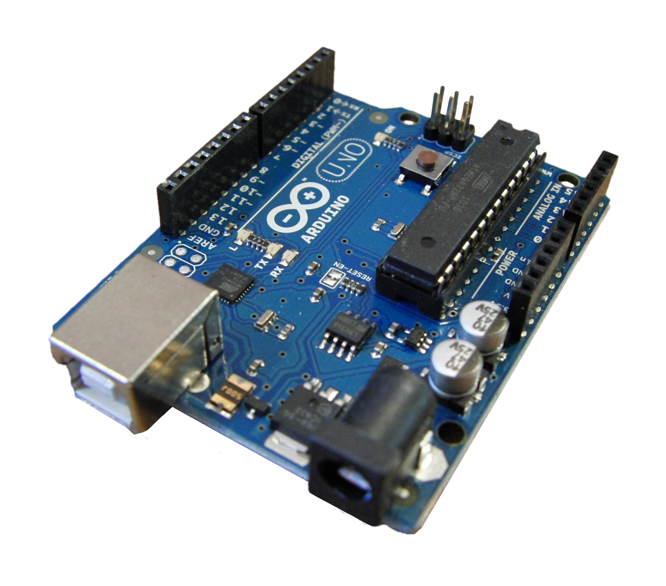
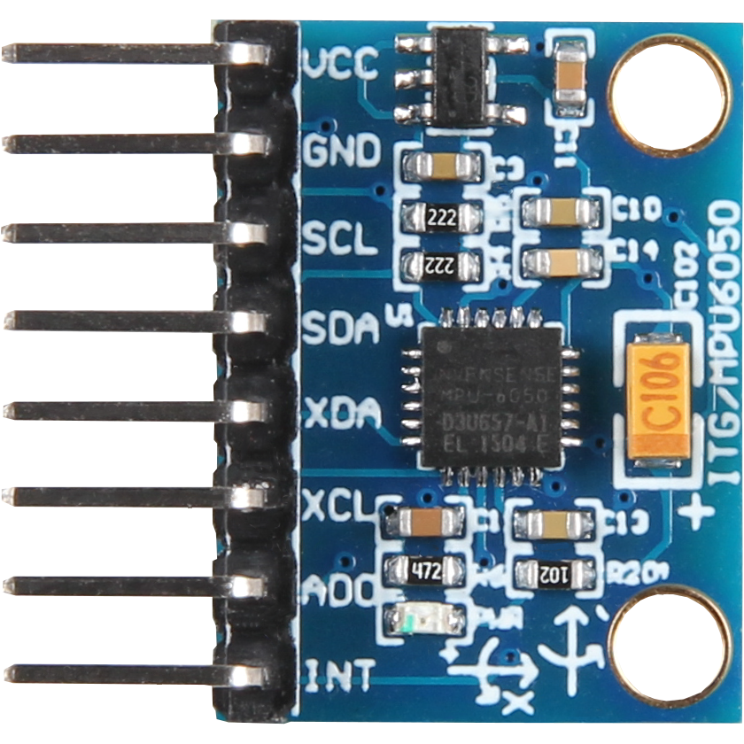
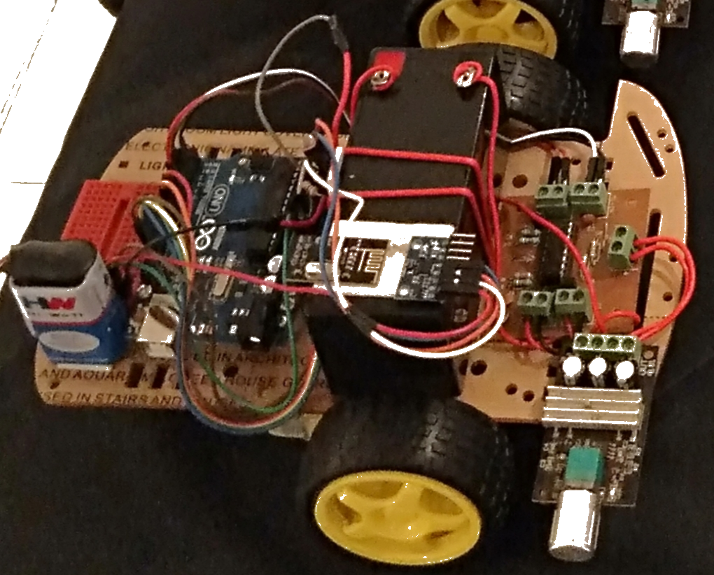
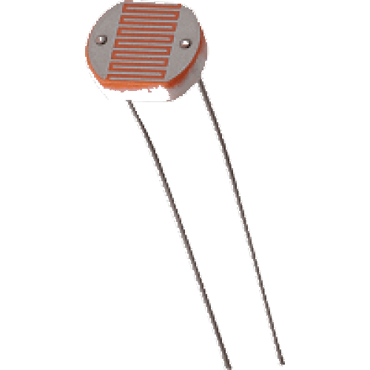

Hardware Implimentation:
NRF 24L01
Arduino
MPU6050
LDR
PS2 Mouse

Slide 10
Applications & Future Works:
Ship Detection
Implement the BMO algorithm using Water bots
Satellite Constellation for BMO Application
Industrial Applications
Transform multi-robotic platform to Quad-rotors platform for more applications

Slide 11
References:
Butterfly Mating Optimization by Chakravarthi Jada, Anil Kumar Vadathya, Anjumara Shaik,Sowmya Charugundla, Parabhaker Reddy Ravulaand Kranthi Kumar Rachavarapu
Butterfly Communication Strategies: A Prospect for Soft-Computing Techniques
Sowmya Ch, Anjumara Shaik, Chakravarthi Jada, Anil Kumar Vadathya 6 papers

Slide 12
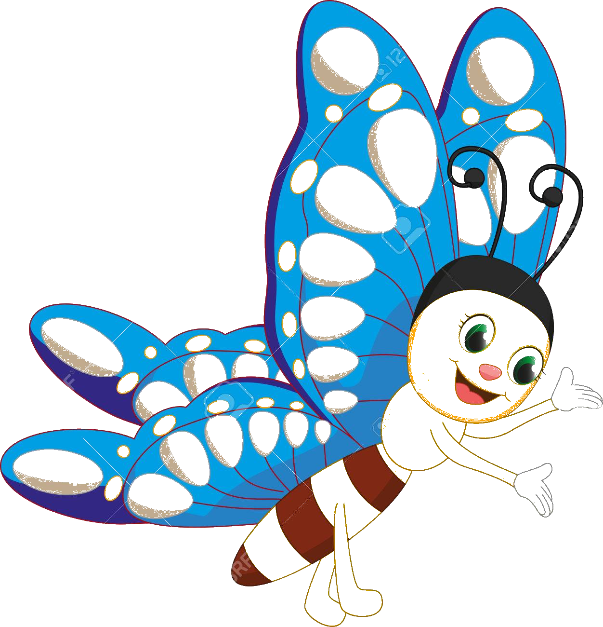
THANK YOU

